Slide 1
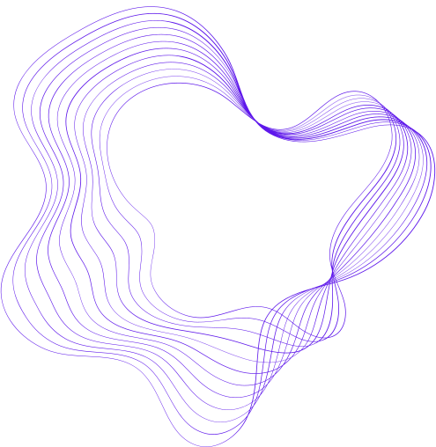

MINDSPACE
www.mindspaceapp.com
Under the guidance of:
Mr. Jay Narayan Thakre

Slide 2

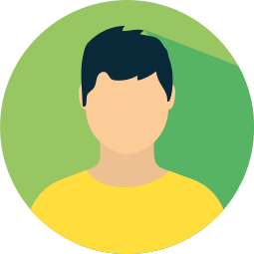
PRESENTED BY
Suraj Dubey
mindspace

Slide 3

A DIGITAL PLATFORM FOR MENTAL WELLNESS
MINDSPACE
CONNECTING MINDS TRANSFORMING LIVES

Slide 4

CONTENT
01
PROBLEM DOMAIN
02
AIM
03
GOALS & OBJECTIVES
04
SOLUTION
05
HARDWARE & SOFTWARE REQUIREMENTS
06
ER DIAGRAM
07
DFD LEVEL-0
08
DFD LEVEL-1
09
DEVELOPMENT LIFECYCLE
10
REFERENCES
00
mindspace

Slide 5
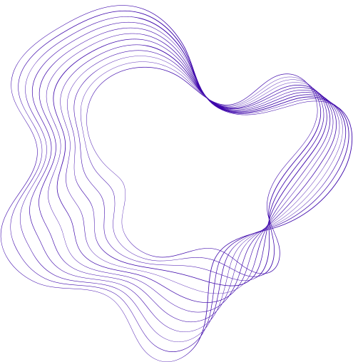

PROBLEM DOMAIN
Busy lifestyles and time constraints hinder individuals from prioritizing their mental well-being.
Lack of motivation makes it challenging for individuals to seek therapy, despite its benefits.
The stigma surrounding mental health creates barriers to accessing therapy.
Privacy and safety concerns discourage individuals from taking the first step toward therapy.
01
mindspace

Slide 6
AIM
Developing a video conferencing application to facilitate mental health support and therapy.
02
mindspace

Slide 7
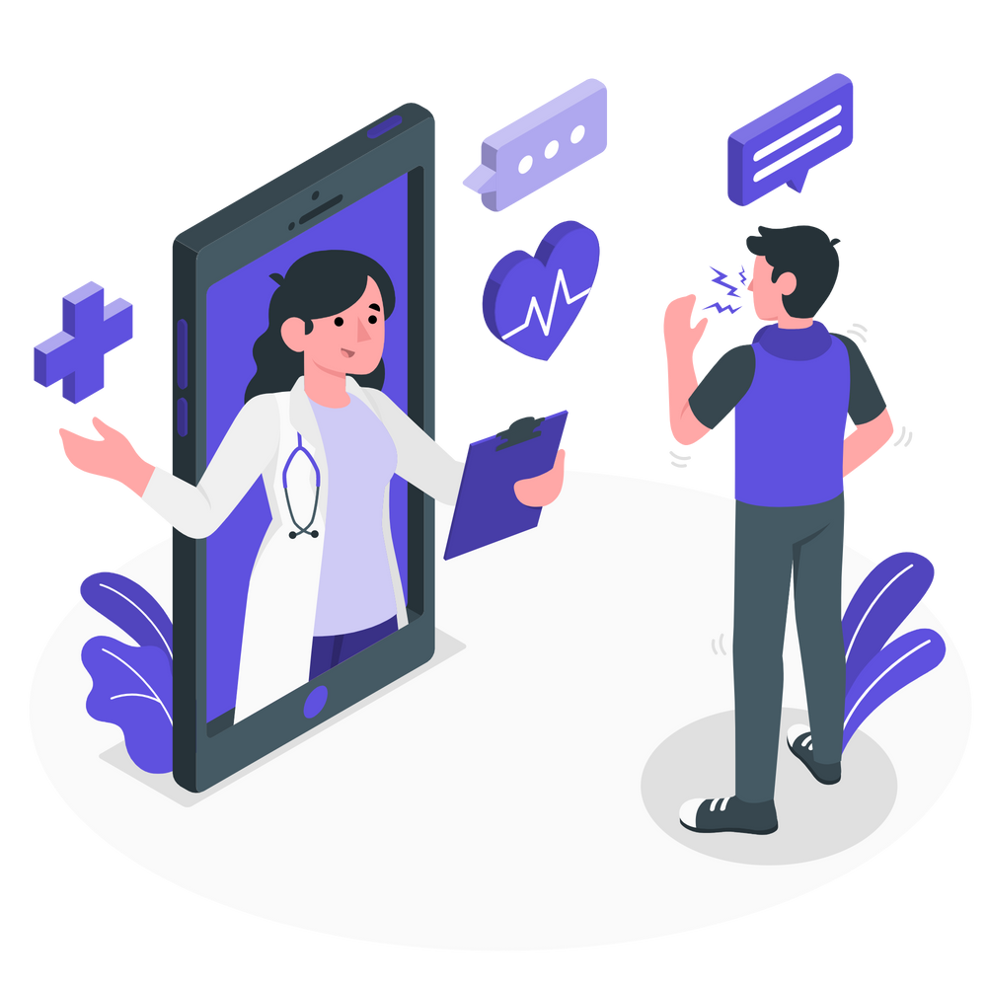


ABOUT US
Our online therapy platform connects patients with licensed therapists, making therapy more accessible and convenient.
Video conferencing technology allows patients to join therapy sessions online, eliminating the need for travel or taking time off work.
03
mindspace

Slide 8






GOALS AND OBJECTIVES
OBJECTIVE N° 1
OBJECTIVE N° 2
OBJECTIVE N° 3
To design and develop a user-friendly web platform for patients to connect with licensed therapists and psychologists for online therapy sessions.
To integrate a reliable and secure video conferencing solution for online therapy sessions.To integrate a reliable and secure video conferencing solution for online therapy sessions.
To provide appointment scheduling and management features for both therapists and patients.
04
mindspace

Slide 9
GOALS AND OBJECTIVES
OBJECTIVE N° 4
OBJECTIVE N° 5
OBJECTIVE N° 6
To enable therapists to create and maintain professional profiles to showcase their qualifications, areas of expertise, and availability.
To ensure that the platform adheres to relevant data privacy and security regulations, protecting the confidentiality of patient information.
To implement secure and compliant payment processing for therapy sessions.
05
mindspace

Slide 10
SOLUTION
Convenient and secure online platform for accessing therapy services.
Elimination of the need for travel, allowing therapy sessions to be conducted from home.
Flexible scheduling options to accommodate busy lifestyles.
Reduction of stigma and increased privacy through virtual therapy sessions.
06
mindspace

Slide 11

HARDWARE REQUIREMENTS
Computer or Laptop: Minimum 4GB RAM and multi-core processor.
Operating System: Compatible with Windows, macOS, and Linux.
Storage: Minimum 10GB free disk space.
Internet Connection: Stable and reliable internet access.
07
mindspace

Slide 12
SOFTWARE REQUIREMENTS
SOFTWARE REQUIREMENTS
01
Node.js: A JavaScript runtime environment required for server-side development
02
Express.js: A fast and minimalist web application framework for Node.js
03
MongoDB: A NoSQL database used for storing and retrieving data
04
React: A JavaScript library for building user interfaces
05
Visual Studio Code (IDE)
06
Version Control System: Github
07
Additional Tools and Libraries
08
mindspace

Slide 13
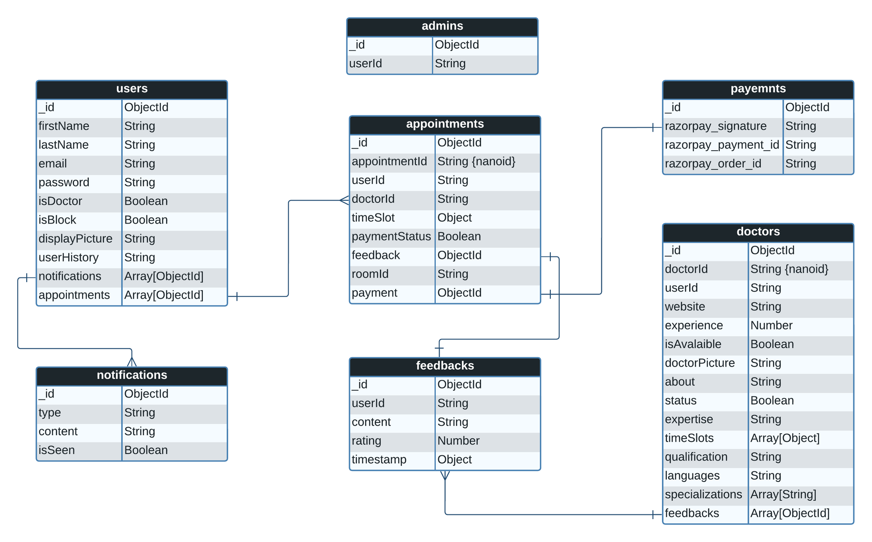
ER DIAGRAM
09
mindspace

Slide 14
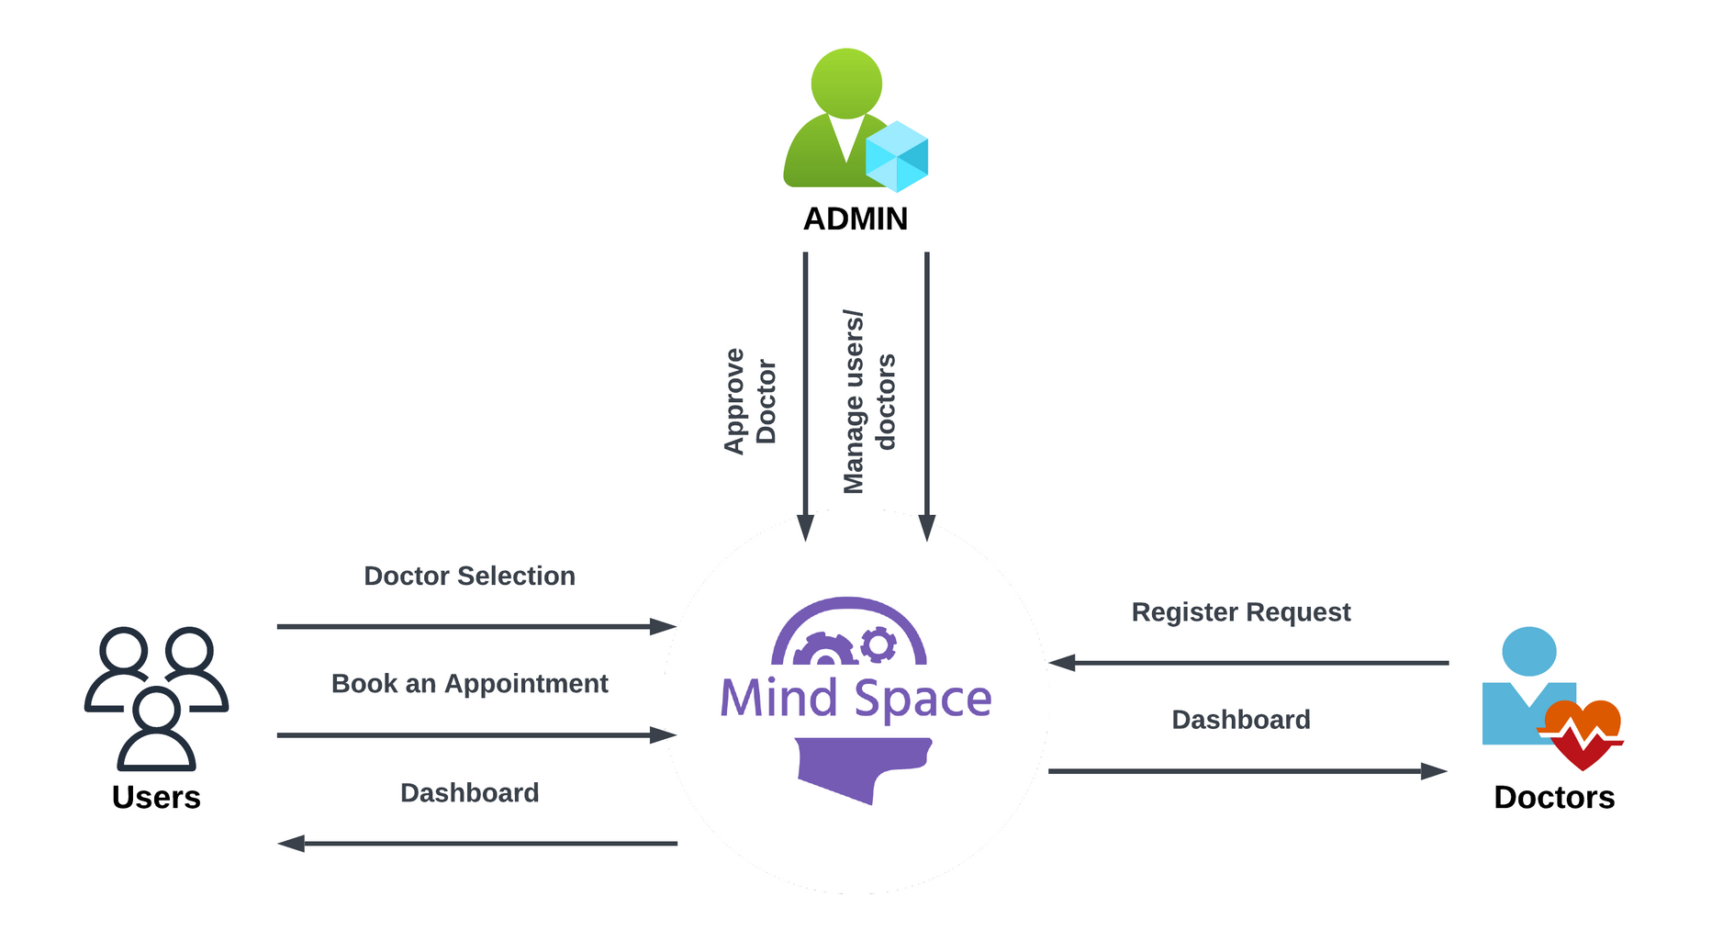
DFD LEVEL-0
10
mindspace

Slide 15
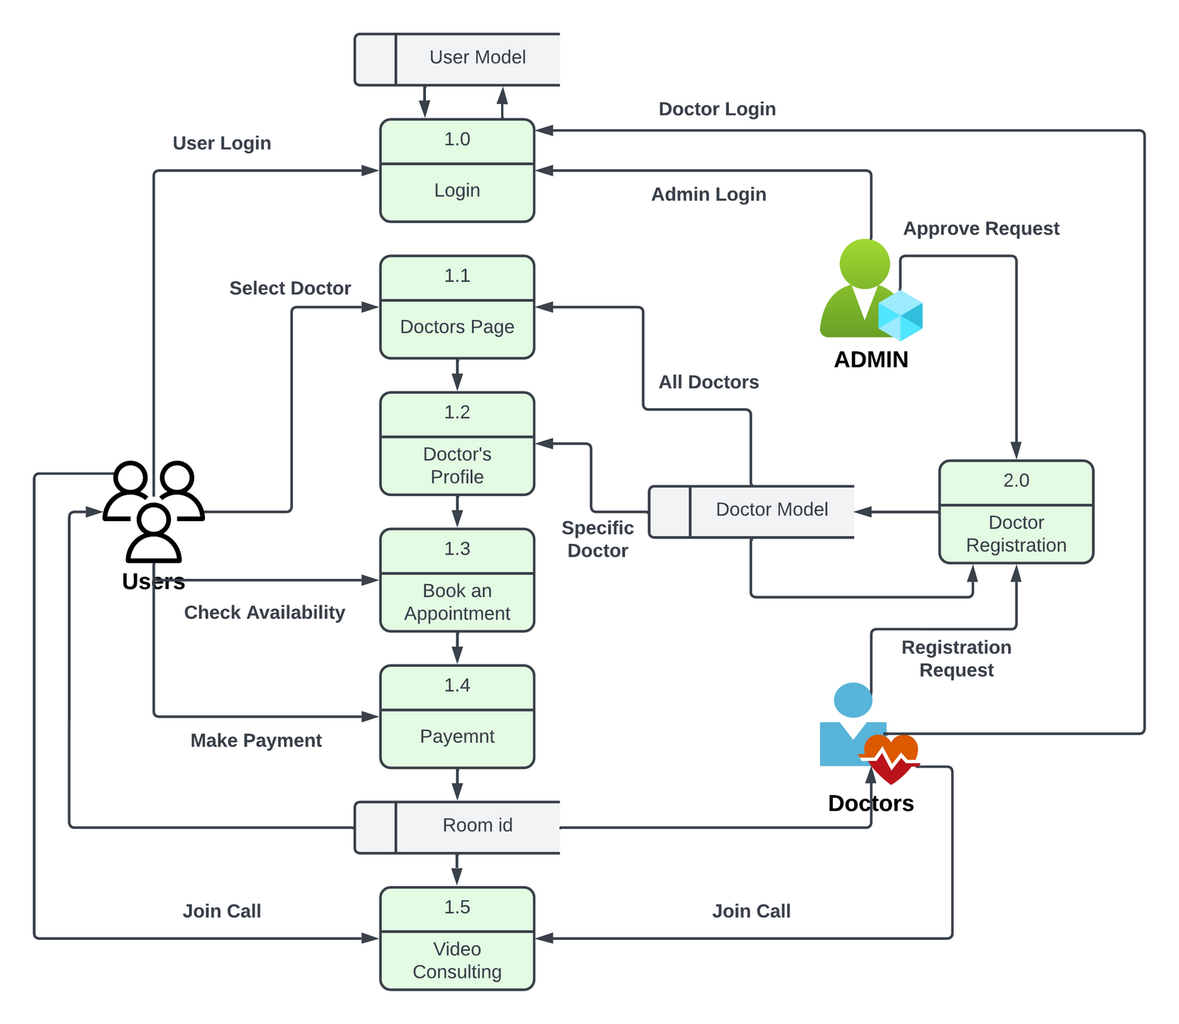
DFD LEVEL-1
11
mindspace

Slide 16

DEVELOPMENT LIFECYCLE
We created a prototype with basic functionality better to understand our product and its core business aspects, enabling us to refine our concept and gain valuable insights for further development.
Introducing our under development web application, featuring an interactive and modern UI designed to engage users. This comprehensive platform includes essential functionalities like secure payment processing and seamless video conferencing between users and doctors. With a robust database, we are working towards creating a fully functional and user-friendly product.
Discover a complete online therapy and consultancy solution. Our platform offers seamless connections with licensed professionals, providing convenient virtual sessions. Say goodbye to traditional appointments and experience accessible mental health support all in one place.
DOCTOR APP
PROTOTYPE
MINDSPACE
{under development}
MINDSPACE
12
mindspace

Slide 17
LET'S LOOK INTO OUR PROJECT...
13
mindspace

Slide 18
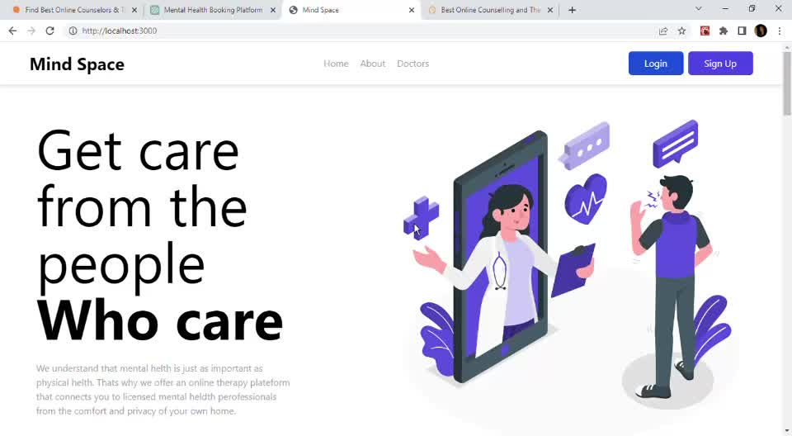

Slide 19
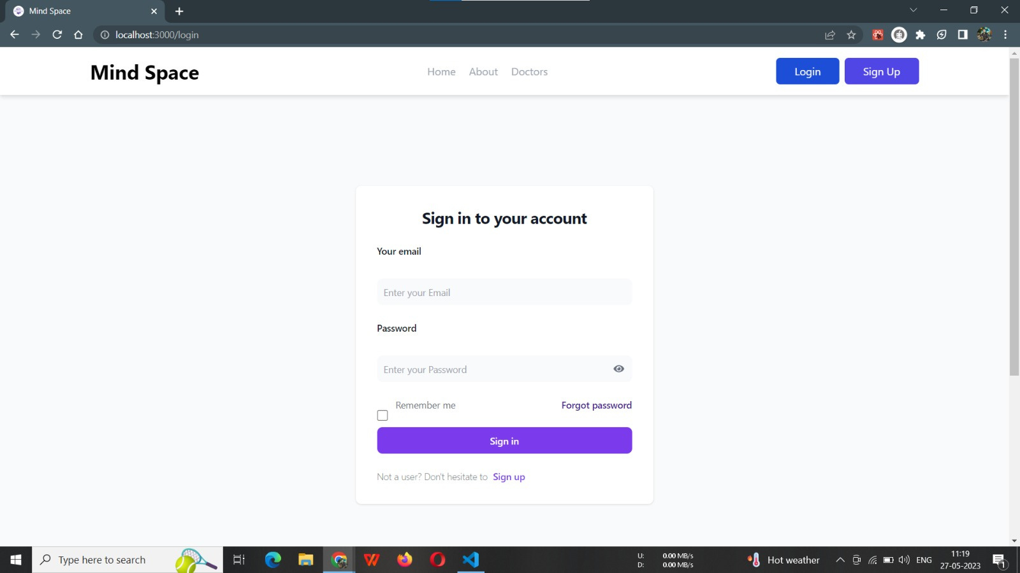

Slide 20
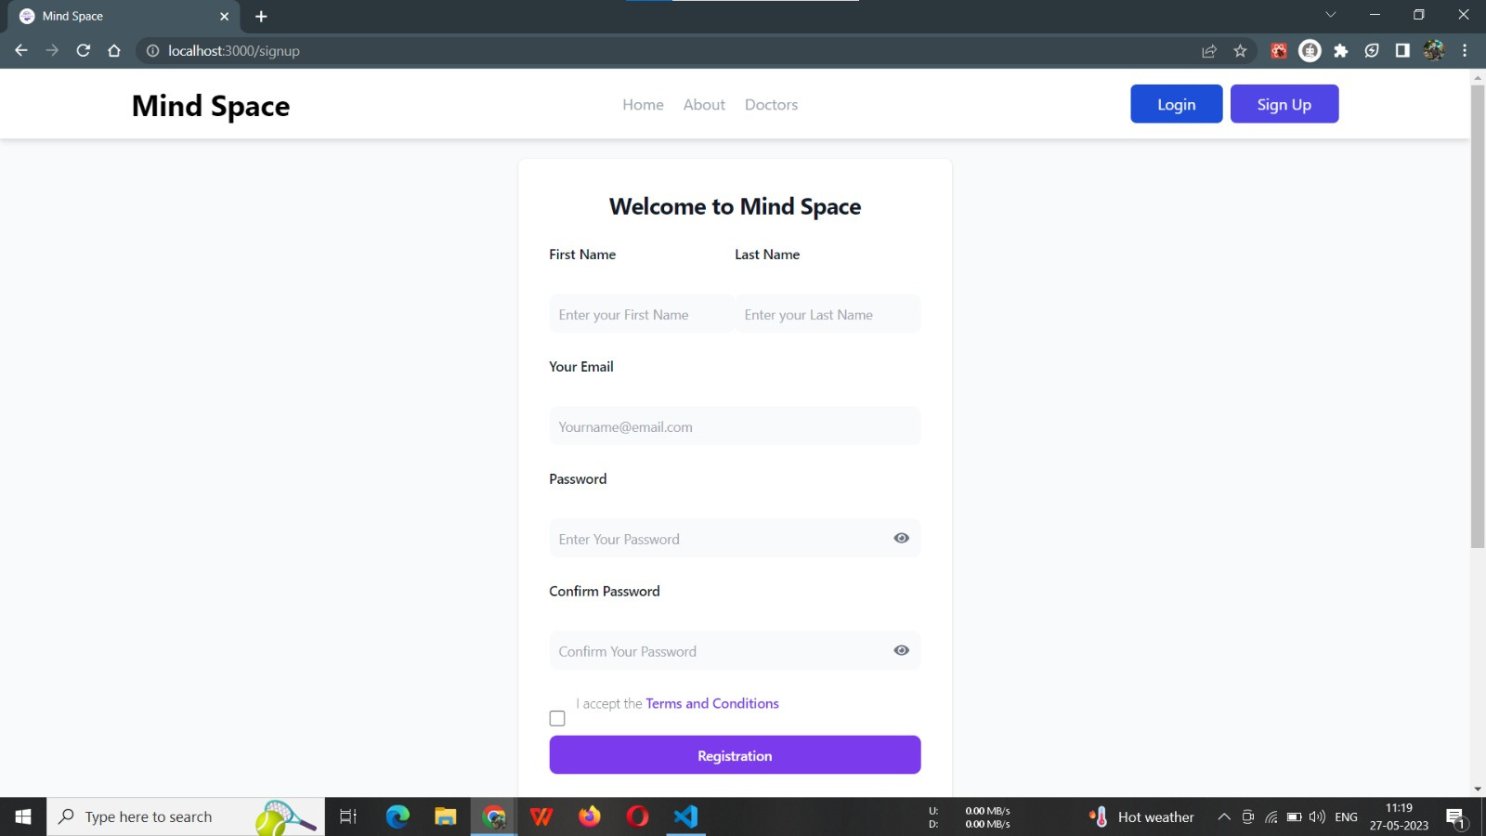

Slide 21
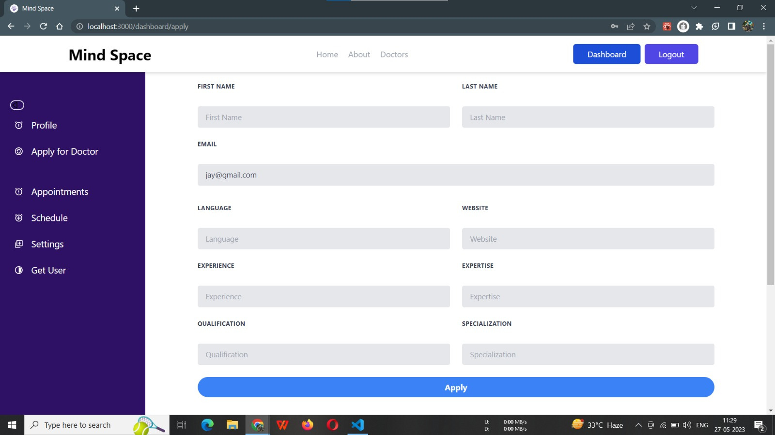

Slide 22
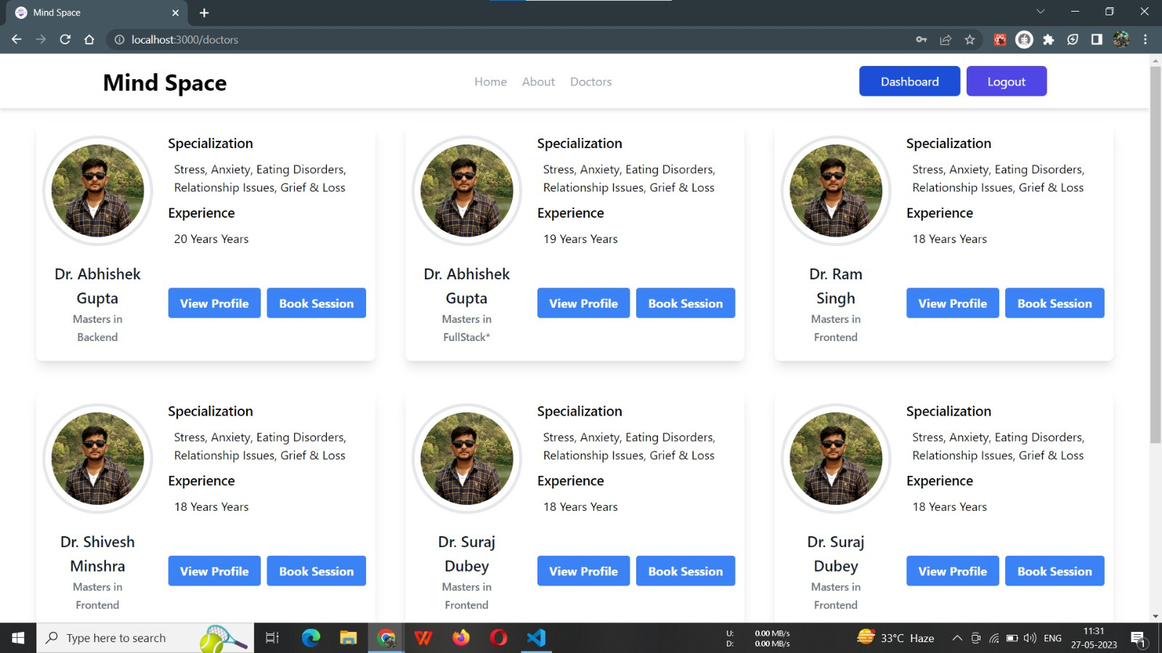

Slide 23
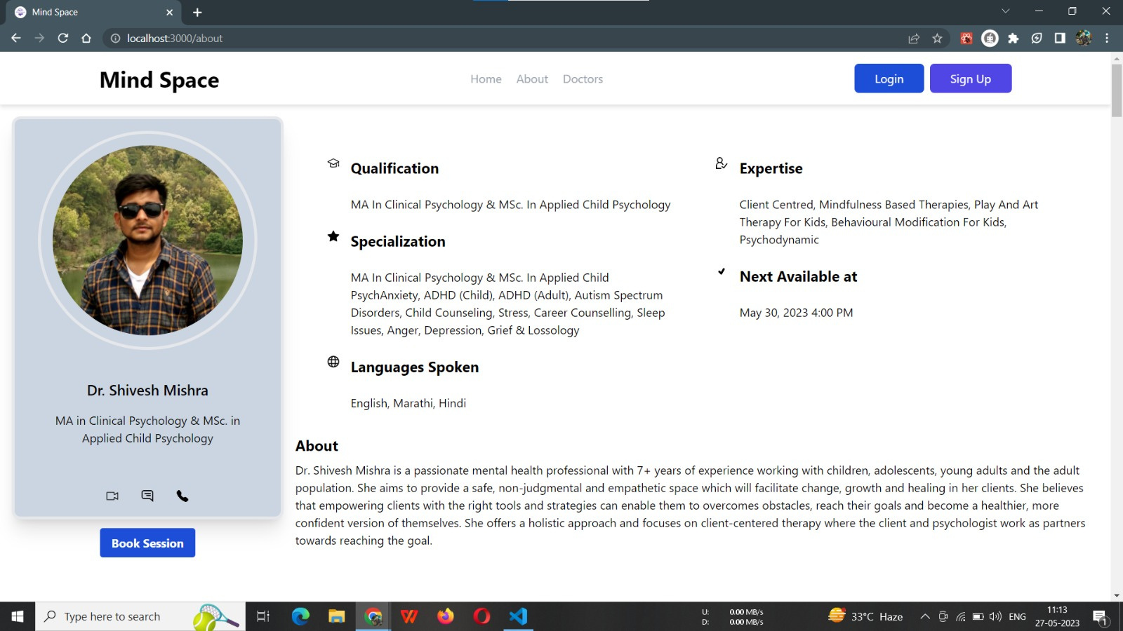

Slide 24
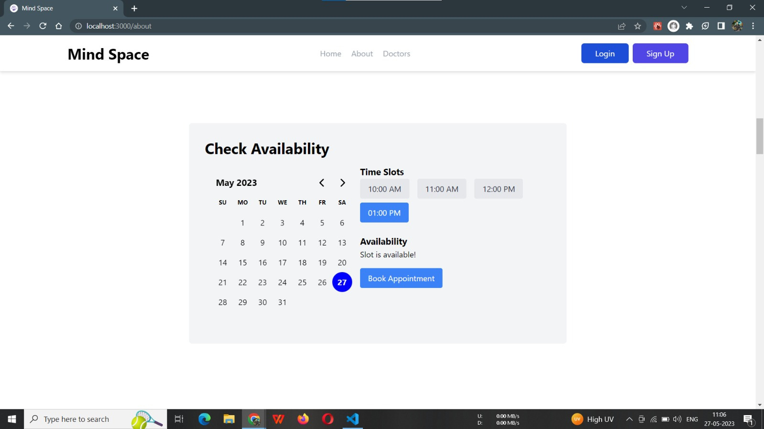

Slide 25
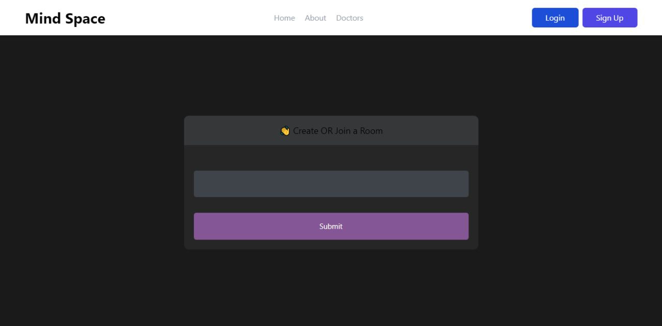

Slide 26
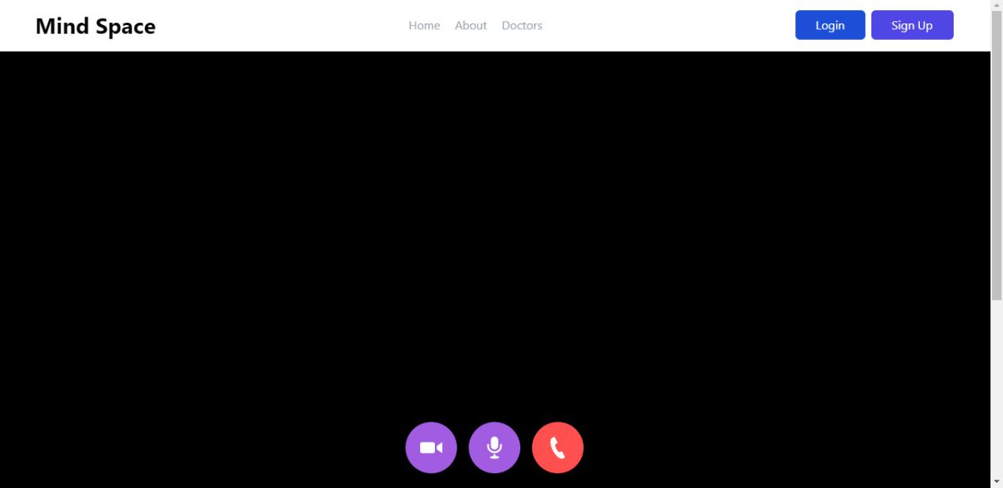

Slide 27
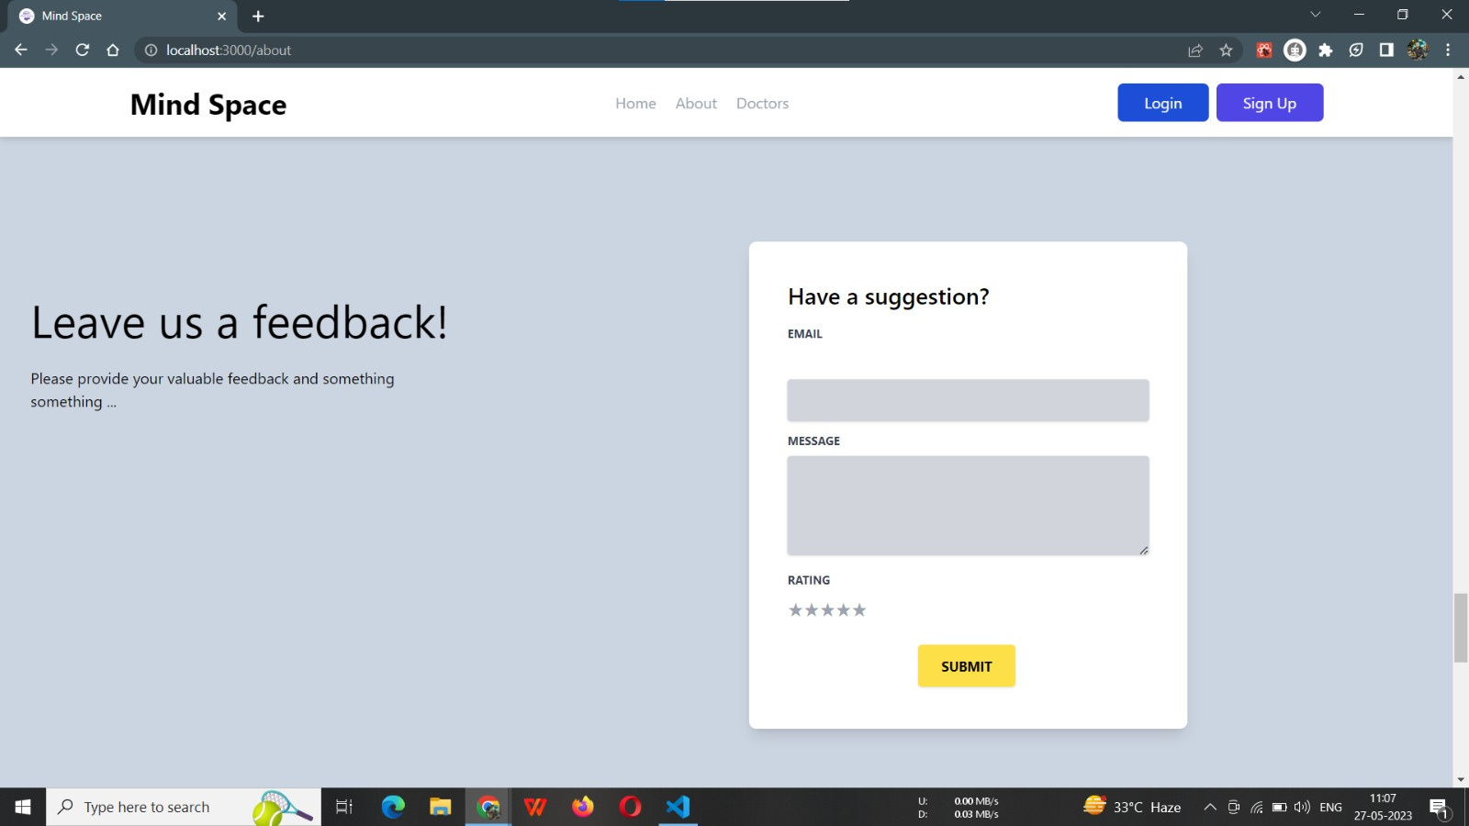

Slide 28
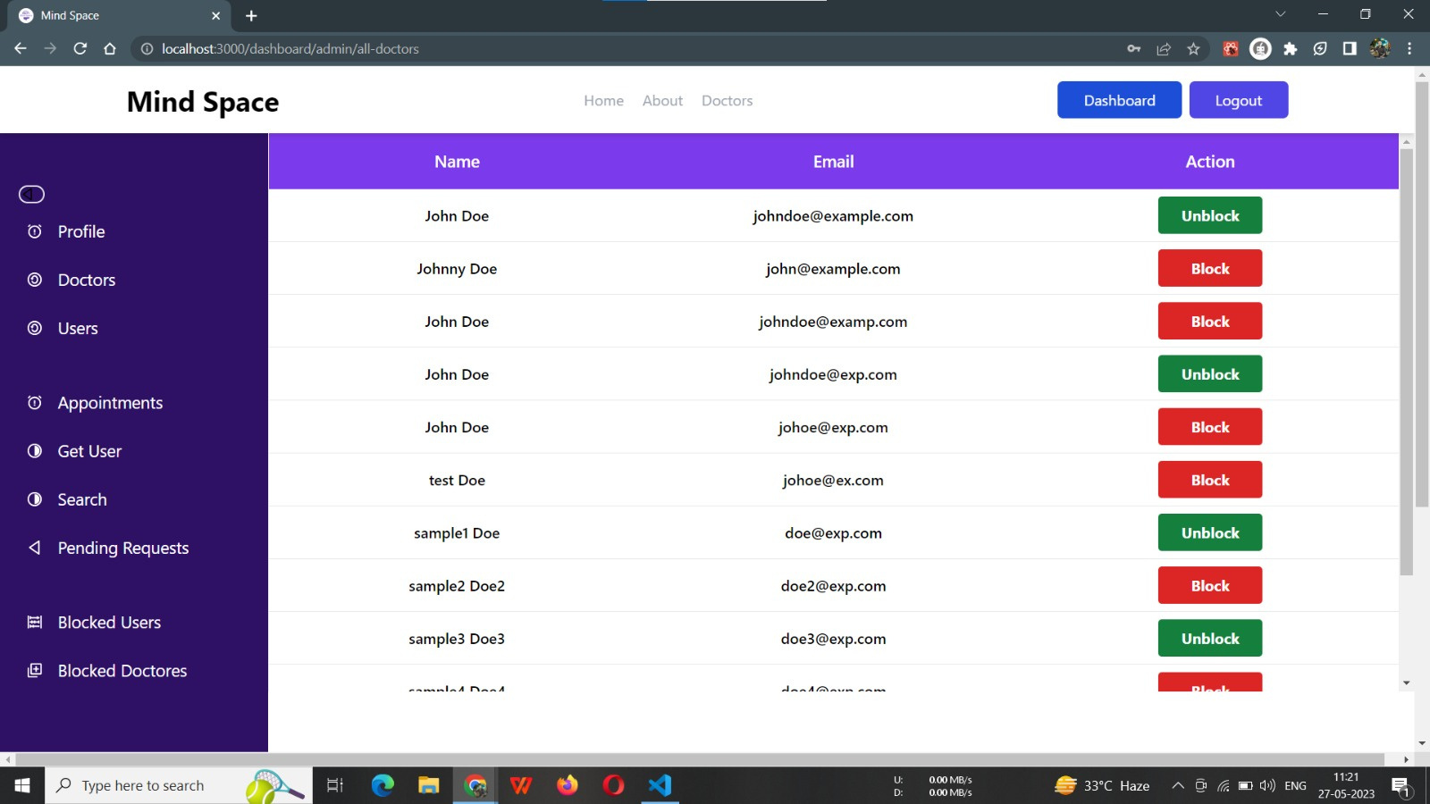

Slide 29
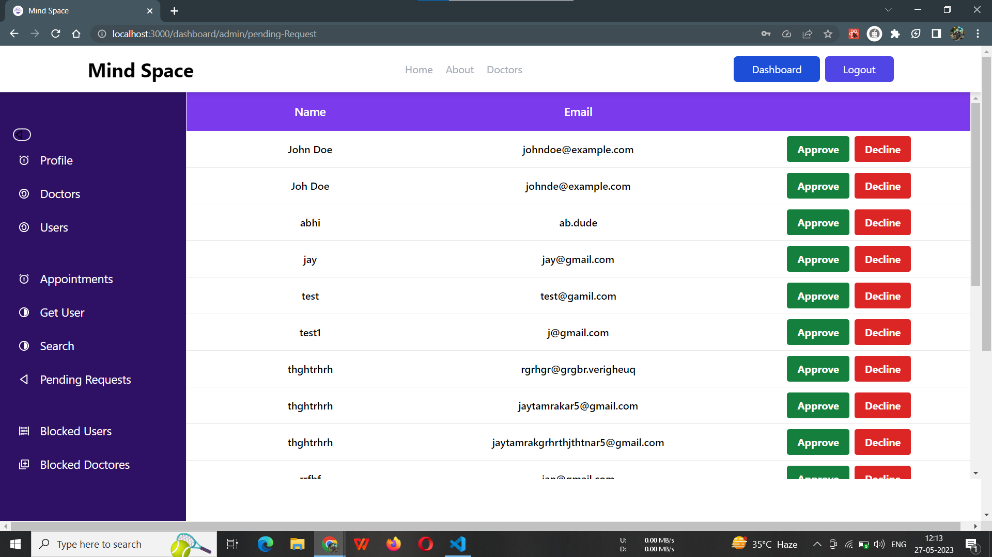

Slide 30
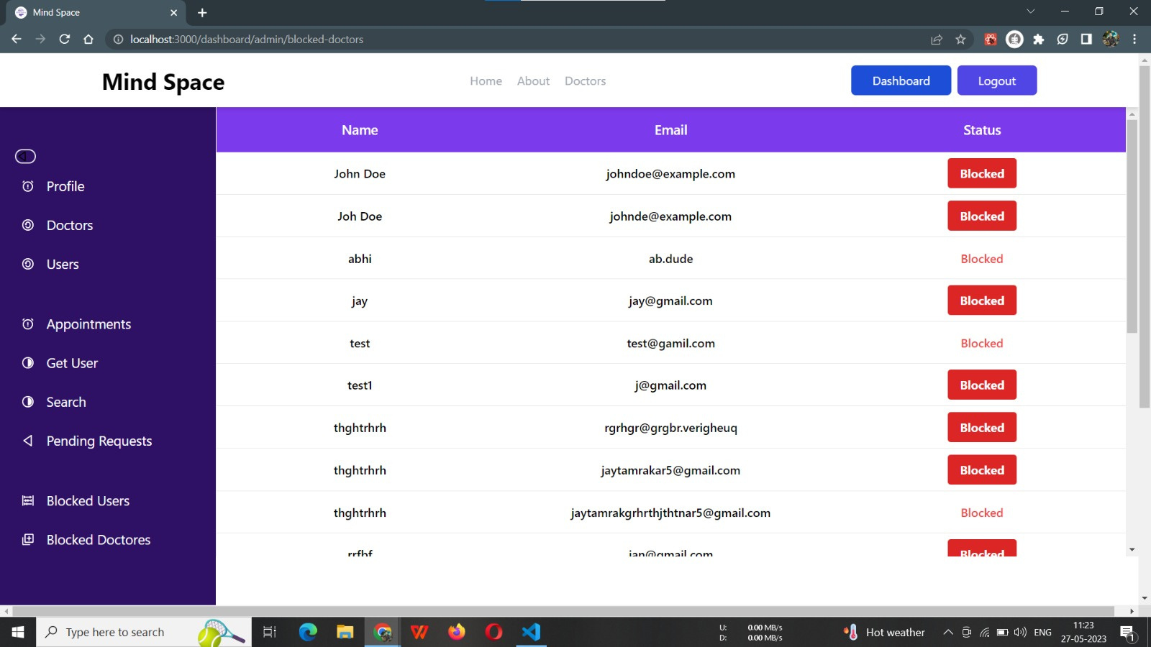

Slide 31
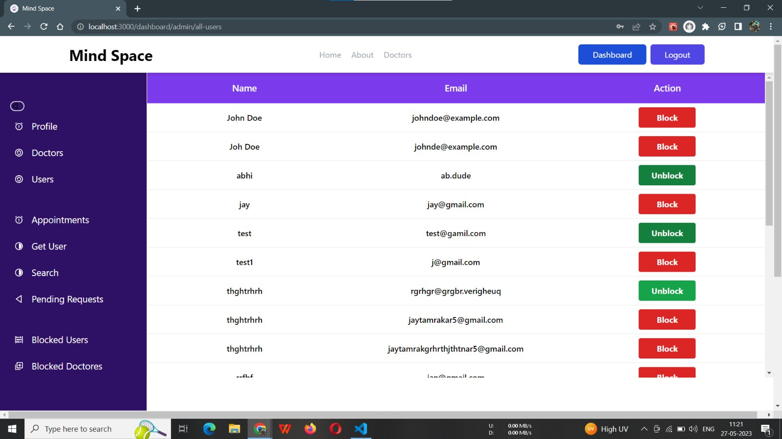

Slide 32
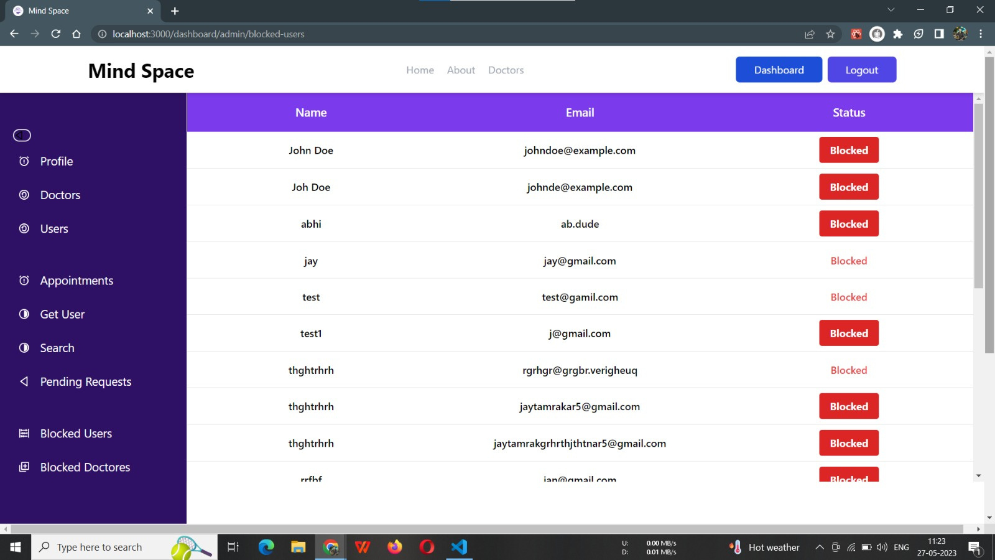

Slide 33
REFERENCES
MongoDB: https://docs.mongodb.com/
Express.js: https://expressjs.com/
React: https://reactjs.org/
Node.js: https://nodejs.org/
React Router: https://reactrouter.com/
Redux (State Management): https://redux.js.org/
Authentication with JWT: https://jwt.io/introduction/.
14
mindspace

Slide 34
THANK YOU!

